Slide 1
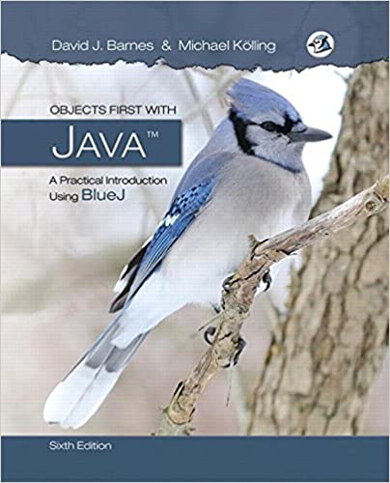
Object-Oriented Programming and Data Abstraction Lesson 6: Coupling
Chapter 12
Notes:
Replace this with your course title and your name/contact details.

Slide 2
Foxes and Rabbits

Slide 3
Simulations
Programs regularly used to simulate real-world activities.
city traffic
the weather
nuclear processes
stock market fluctuations
environmental changes
network operation and performance
They are often only partial simulations.
They often involve simplifications.
Greater detail has the potential to provide greater accuracy.
Greater detail typically requires more resource.
Processing power.
Simulation time.
Benefits
Support useful prediction. E.g.m weather.
Allow experimentation. -- safer, cheaper, quicker.
Example: ‘How will the wildlife be affected if we cut a highway through the middle of this national park?’

Slide 4
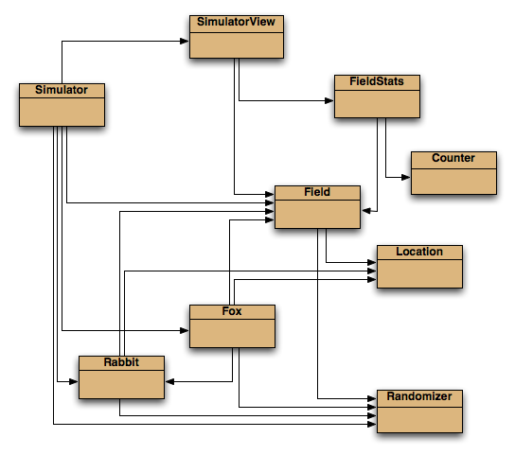
Predator-prey simulations Foxes and Rabbits
There is often a delicate balance between species.
A lot of prey means a lot of food.
A lot of food encourages higher predator numbers.
More predators eat more prey.
Less prey means less food.
Less food means ...

Slide 5
Main classes of interest
Fox
Simple model of a type of predator.
Rabbit
Simple model of a type of prey.
Simulator
Manages the overall simulation task.
Holds a collection of foxes and rabbits.
Field
Represents a 2D field.
Location
Represents a 2D position.
SimulatorView, FieldStats, Counter
Maintain statistics and present a view of the field.
During each step
Steps do not correspond to real time
Simulation step carries out the actions that characterize fox and rabbit behavior.
The state of the simulation is updated.
Corresponding changes are displayed on the screen

Slide 6
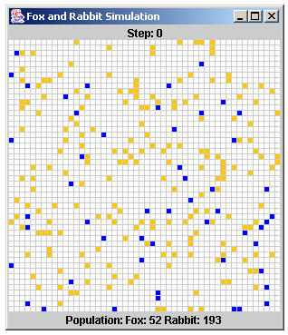
Example of the visualization

Slide 7
Animal Behavior
Rabbit Simplification examples
Rabbits do not have different genders. In effect, all are female.
The same rabbit could breed at every step.
All rabbits die at the same age.
No two animals in the same location
Rabbit behavior
Managed from the run method.
Age incremented at each simulation ‘step’.
A rabbit could die at this point.
Rabbits that are old enough might breed at each step.
New rabbits could be born at this point.
Rabbis can die either because of
Old age
Overpopulation: No place to move to during it’s run
Fox Simplification examples
Similar simplifications to rabbits.
Hunting and eating could be modeled in many different ways.
Should food level be additive?
Is a hungry fox more or less likely to hunt?
Fox behavior
Managed from the hunt method.
Foxes also age and breed.
They become hungry.
They hunt for food in adjacent locations.

Slide 8
The Simulator class
Three key components:
Setup in the constructor.
The populate method.
Each animal is given a random starting age.
The simulateOneStep method.
Iterates over separate populations of foxes and rabbits.
“Run” all the rabbits in the field
“Hunt” all the foxes in the field
Add newborn rabbits and foxes to the lists
Update GUI with new information

Slide 9
Room for improvement
Fox and Rabbit have strong similarities but do not have a common superclass.
The update step involves similar-looking code.
The Simulator is tightly coupled to specific classes.
It ‘knows’ a lot about the behavior of foxes and rabbits.
Place common fields in Animal superclass
age, alive, field, location
Place corresponding accessors and mutators in class Animal
getLocation, setLocation,…
May need to change access modifiers for moved methods
Method renaming to support information hiding:
“Acting” methods specific to individual animals get a common name
run and hunt become act.
Simulator can now be significantly decoupled.

Slide 10
The act method of Animal
Static type checking requires an act method in Animal.
An act method for foxes and rabbits is different
There is no obvious shared implementation
Leave method act in Animal empty or define it as abstract: abstract public void act(List<Animal> newAnimals);

Slide 11
The Animal class
public abstract class Animal
{
fields omitted
/**
* Make this animal act - that is: make it do
* whatever it wants/needs to do.
*/
abstract public void act(List<Animal> newAnimals);
other methods omitted
}

Slide 12
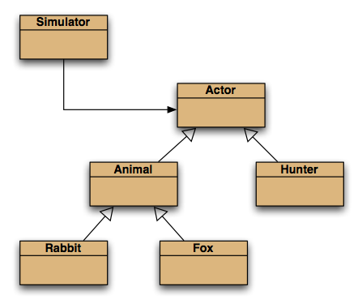
Further abstraction

Slide 13
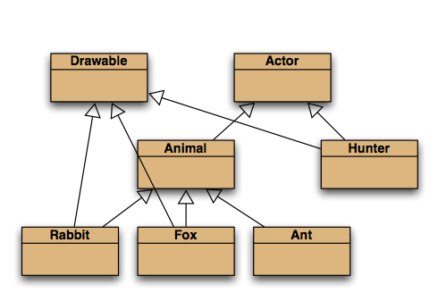
Selective drawing (multiple inheritance)

Slide 14
Foxes and Rabbits Appendix

Slide 15
A Rabbit’s state
public class Rabbit {
// The age at which a rabbit can start to breed.
private static final int BREEDING_AGE = 5;
// The age to which a rabbit can live.
private static final int MAX_AGE = 40;
// The likelihood of a rabbit breeding.
private static final double BREEDING_PROBABILITY = 0.15;
// The maximum number of births.
private static final int MAX_LITTER_SIZE = 4;
// A shared random number generator to control breeding.
private static final Random rand = Randomizer.getRandom();
// The rabbit's age.
private int age;
// Whether the rabbit is alive or not.
private boolean alive;
// The rabbit's position
private Location location;
// The field occupied
private Field field;
…
}

Slide 16
A Rabbit’s behavior
Managed from the run method.
Age incremented at each simulation ‘step’.
A rabbit could die at this point.
Rabbits that are old enough might breed at each step.
New rabbits could be born at this point.
Rabbis can die either because of
Old age
Overpopulation:
No place to move to during it’s run

Slide 17
A Rabbit’s behavior (1)
/** This is what the rabbit does most of the time - it runs
* around. Sometimes it will breed or die of old age.
* @param newRabbits A list to add newly born rabbits to.
*/
public void run(List<Rabbit> newRabbits) {
incrementAge();
if(alive) {
giveBirth(newRabbits);
// Try to move into a free location.
Location newLocation = field.freeAdjacentLocation(location);
if(newLocation != null) {
setLocation(newLocation);
}
else {
// Overcrowding.
setDead();
}
}
}

Slide 18
A Rabbit’s behavior (2)
/**
* Check whether or not this rabbit is to give birth at this step.
* New births will be made into free adjacent locations.
* @param newRabbits A list to add newly born rabbits to.
*/
private void giveBirth(List<Rabbit> newRabbits)
{
// New rabbits are born into adjacent locations.
// Get a list of adjacent free locations.
List<Location> free = field.getFreeAdjacentLocations(location);
int births = breed();
for(int b = 0; b < births && free.size() > 0; b++) {
Location loc = free.remove(0);
Rabbit young = new Rabbit(false, field, loc);
newRabbits.add(young);
}
}

Slide 19
A Rabbit’s behavior (3)
/**
* Generate a number representing the number of births,
* if it can breed.
* @return The number of births (may be zero).
*/
private int breed()
{
int births = 0;
if(canBreed() && rand.nextDouble() <= BREEDING_PROBABILITY) {
births = rand.nextInt(MAX_LITTER_SIZE) + 1;
}
return births;
}

Slide 20
A Rabbit’s behavior (4)
/**
* Indicate that the rabbit is no longer alive.
* It is removed from the field.
*/
public void setDead()
{
alive = false;
if(location != null) {
field.clear(location);
location = null;
field = null;
}
}
Should this method update the ArrayList that contains all Rabbits in the simulation? Why or why not?

Slide 21
A Fox’s behavior
Managed from the hunt method.
Foxes also age and breed.
They become hungry.
They hunt for food in adjacent locations.

Slide 22
A Fox’s state
public class Fox {
// The age at which a fox can start to breed.
private static final int BREEDING_AGE = 10;
// The age to which a fox can live.
private static final int MAX_AGE = 150;
// The likelihood of a fox breeding.
private static final double BREEDING_PROBABILITY = 0.35;
// The maximum number of births.
private static final int MAX_LITTER_SIZE = 5;
// The number of steps a fox can go before it has to eat again.
private static final int RABBIT_FOOD_VALUE = 7;
…
// The fox's age.
private int age;
// Whether the fox is alive or not.
private boolean alive;
// The fox's position
private Location location;
// The field occupied
private Field field;
// The fox's food level, which is increased by eating rabbits.
private int foodLevel;
…
}

Slide 23
A Fox’s behavior (1)
/**This is what the fox does most of the time: it hunts for rabbits. In the
* process, it might breed, die of hunger, or die of old age.
* @param field The field currently occupied.
* @param newFoxes A list to add newly born foxes to.
*/
public void hunt(List<Fox> newFoxes) {
incrementAge();
incrementHunger();
if(alive) {
giveBirth(newFoxes);
Location newLocation = findFood(location);
// Move towards a source of food if found.
if(newLocation == null) { // No food found:
newLocation = field.freeAdjacentLocation(location);
// Try to move to a free location.
}
if(newLocation != null) { // See if it was possible to move.
setLocation(newLocation);
}
else {
// Overcrowding.
setDead();
}
}
}

Slide 24
A Fox’s behavior
/** Tell the fox to look for rabbits adjacent to its current location.
* Only the first live rabbit is eaten.
* @param location Where in the field it is located.
* @return Where food was found, or null if it wasn't.
*/
private Location findFood(Location location) {
List<Location> adjacent = field.adjacentLocations(location);
Iterator<Location> it = adjacent.iterator();
while(it.hasNext()) {
Location where = it.next();
Object animal = field.getObjectAt(where);
if(animal instanceof Rabbit) {
Rabbit rabbit = (Rabbit) animal;
if(rabbit.isAlive()) {
rabbit.setDead();
foodLevel = RABBIT_FOOD_VALUE;
// foodLevel += RABBIT_FOOD_VALUE ???
return where;
// Remove the dead rabbit from the field.
}
}
}
return null;
}

Slide 25
The Simulator class
// The default size of the grid.
private static final int DEFAULT_WIDTH = 50;
private static final int DEFAULT_DEPTH = 50;
// The probability that a fox will be created in any given grid position.
private static final double FOX_CREATION_PROBABILITY = 0.02;
// The probability a rabbit will be created in any given grid position.
private static final double RABBIT_CREATION_PROBABILITY = 0.08;
// Lists of animals in the field.
// Separate lists are kept for ease of iteration.
private List<Rabbit> rabbits;
private List<Fox> foxes;
// The current state of the field. e.g., animal locations in the field
private Field field;
// The current step of the simulation.
private int step;
// A graphical view of the simulation.
private SimulatorView view;

Slide 26
The update step
for(Iterator<Rabbit> it = rabbits.iterator(); it.hasNext(); )
{
Rabbit rabbit = it.next();
rabbit.run(newRabbits);
if(! rabbit.isAlive()) {
it.remove();
}
}
…
for(Iterator<Fox> it = foxes.iterator(); it.hasNext(); ) {
Fox fox = it.next();
fox.hunt(newFoxes);
if(! fox.isAlive()) {
it.remove();
}
}
rabbits.addAll(newRabbits);
foxes.addAll(newFoxes);
view.showStatus(step, field);

